Slide 1


ACS COLLEGE OF ENGINEERING DEPARTMENT OF ELECTRONICS AND COMMUNICATION ENGINEERING
SUBJECT CODE: 18ECMP68 SUBJECT: MINI PROJECT
SEMESTER: VI
TOPIC : FINGERPRINT DOOR LOCK SYSTEM
CARRIED OUT BY:
Bahubali Raj A 1AH20EC004
Mohammed Jawad 1AH20EC010
Mohammed Mustaqeem 1AH20EC011
Mohammed Touheed 1AH20EC012
With the guidance of:
Dr A M Prasanna Kumar
B.E(E&C).,M.E(P.E).,Ph.D(VTU).,FIE.,LMISTE.,
PROFESSOR AND PRINCIPAL OF
ACS COLLEGE OF ENGINEERING, BANGLORE

Slide 2
CONTENTS
PROBLEM DEFINATION
INTRODUCTION
LITERATURE SURVEY
BLOCK DIAGRAMS AND FLOW CHARTS
COMPONENTS AND OBJECTIVES
METHODOLOGY
ADVANTAGES AND DISADVANTAGES
EXPECTED OUTCOME
REFERENCES

Slide 3
PROBLEM DEFINATION
Usually or by mistake we may forget the keys for specific door locks, in this emergency durations we can use this techniques before.
In olden technics, we use watchman/guard to look after the valuable jewels or boxes or homes in order to control the burglar[Theft] , here one human work is entirely dedicated for this work.
In the recent days, the cameras were adopted in specific places to avoid the guards, but the cameras don’t recognizes the burglar and hence a guard or house owners are recommended to monitor.
In some durations, there may be a chances of burglar entering the door in the case where none of them are monitoring , in these specific cases we require some specific lock system.

Slide 4
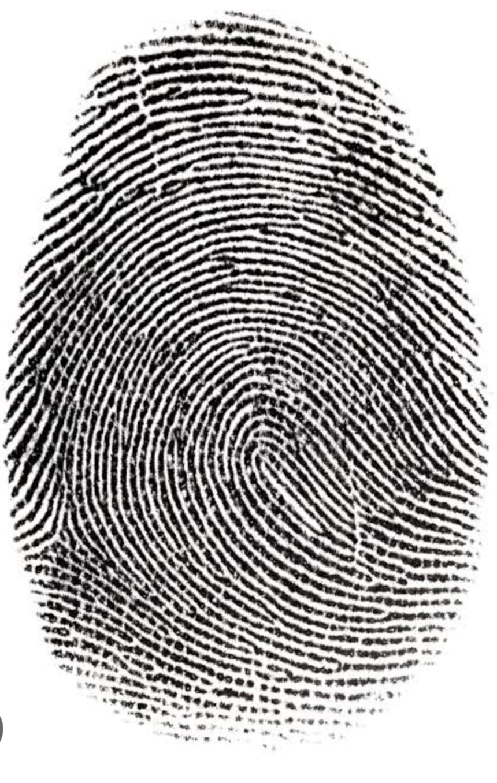
INTRODUCTION
By the basics, all the humans in the entire world has unique fingerprints in each and every fingers and toes.
By this uniqueness, we design the lock systems and its impossible to cheat the lock.
We use the Arduino uno as the main host of the system it recognize the fingerprints and opens the door accordingly.
This involves no keys for opening the door and its super quick to operate the lock.

Slide 5
LITERATURE SURVEY
SL NO | TOPICS | AUTHOR | PUBLISHED BY | YEAR | TECHNOLOGY USED
1 | FINGERPRINT DOOR LOCK SYSTEM | 1. MD. KHAYRUL ISLAM 2. ALLIMUL RAJEE | MD. KHAYRUL ISLAM | 2023 | Biometric technology
2 | PASSWORD BASED SMART DOOR LOCKING SYSTEM | MD. AL IMRAN WAHID SABBIR | MD. AL IMRAN | 2022 | Password keypad
3 | AUTOMATIC DOOR LOCK SYSTEM | ALI HUSSAIN | ALI HUSSAIN | 2022 | Electromagnatic and sensor technology

Slide 6
LITERATURE SURVEY
SL NO | TOPICS | AUTHOR | PUBLISHED BY | YEAR | TECHNOLOGY USED
4 | RFID AND BLUETOOTH BASED SMART DOOR LOCKING SYSTEM | SANDESH PARAJULI | SANDESH PARAJULI | 2021 | Non- contact and bluetooth technology
5 | SMART DOOR LOCK WITH AN EMBEDDED SPY CAMERAS | FALOHUN A.S. OLUWOLE ADEGBOLA BUKOLA O MAKINDE TITIPOLE HELEN AKIN OLAYEMI | ABAYOMI EBENEZER ADEYEGE | 2021 | TOF sensor

Slide 7
BLOCK DIAGRAM
IF
Input
(fingerprint)
Arduino uno
(processor)
MATCHES
Output
(opens lock )
Memory
(2D data stored)

Slide 8
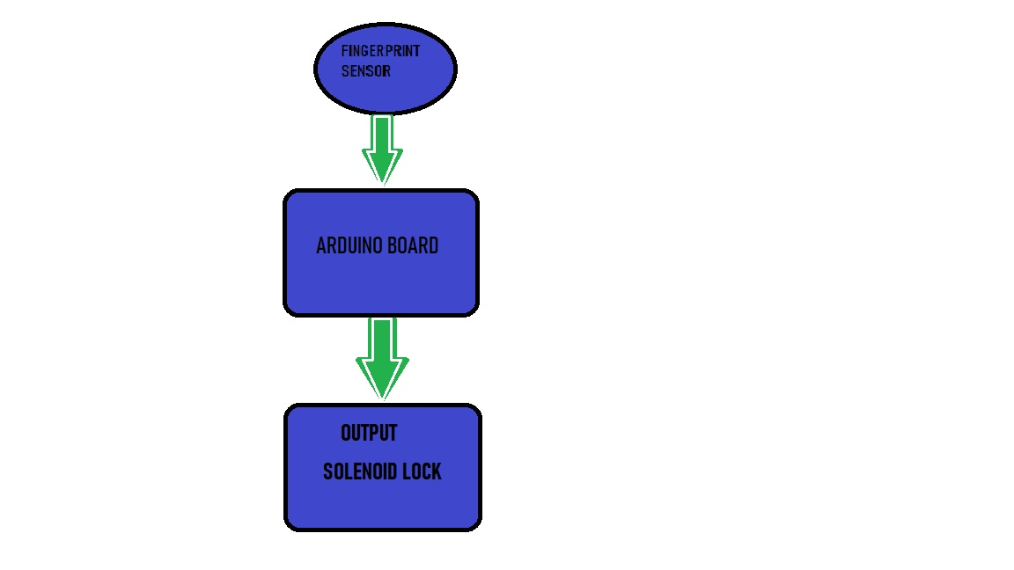
FLOW CHART

Slide 9
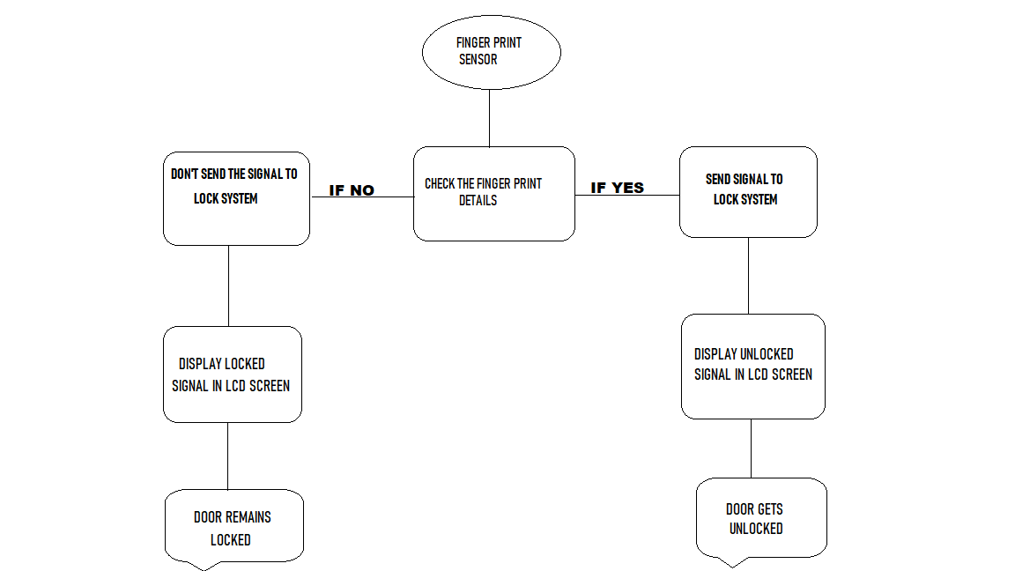
FUNCTIONAL DIAGRAM

Slide 10
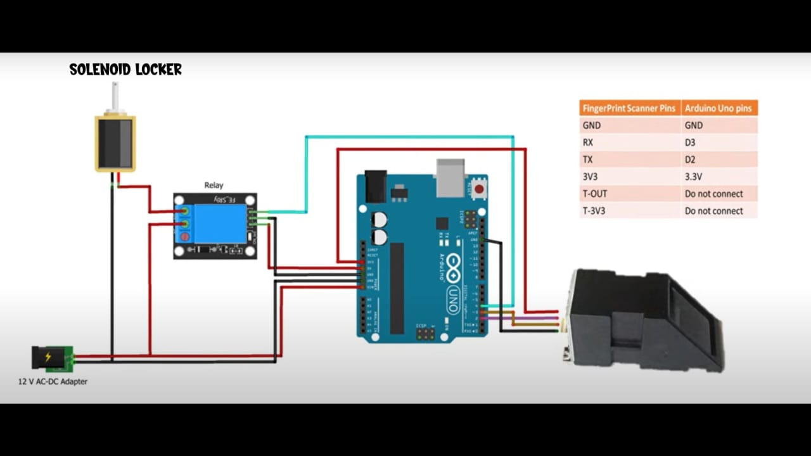
CIRCUIT DIAGRAM

Slide 11
COMPONENTS REQUIRED
Arduino uno
Fingerprint sensor
Solenoid lock
TIP122 transistor
5 Volts Relay
DC Batteries
Wires

Slide 12
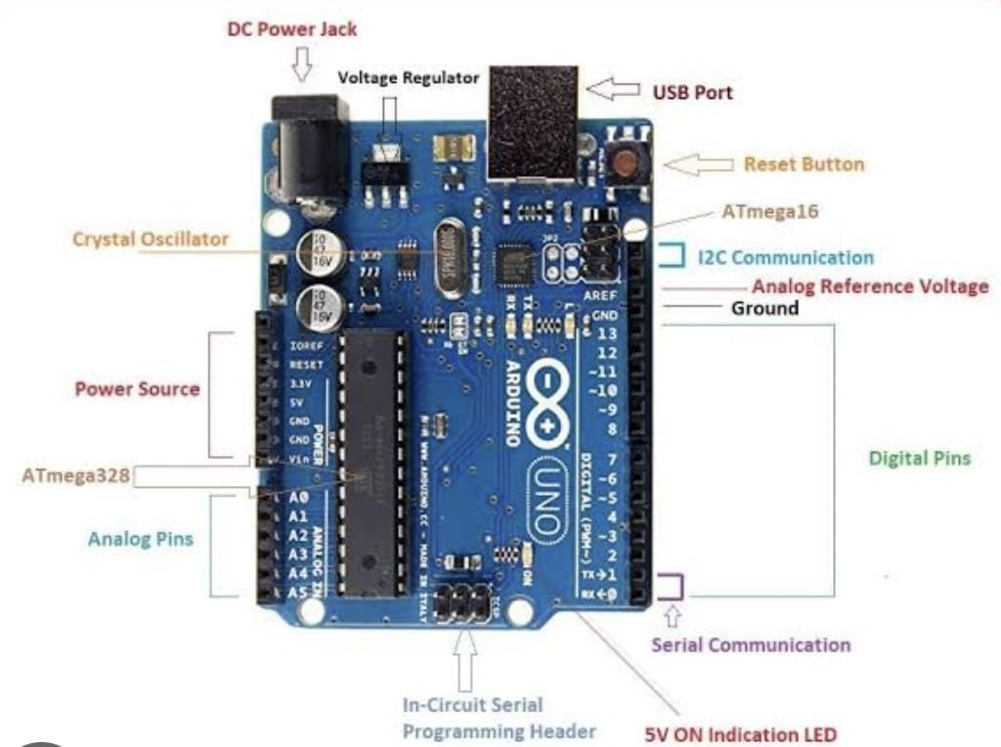
ARDUINO UNO
Arduino UNO is a microcontroller board based on the ATmega328P, It has 14 digital I/O pins, 6 Analog inputs, a 16 MHz ceramic resonator , a USB cable connection, a power jack , an ICSP header and a reset button.
Programming is done by using ArduinoIDE software

Slide 13
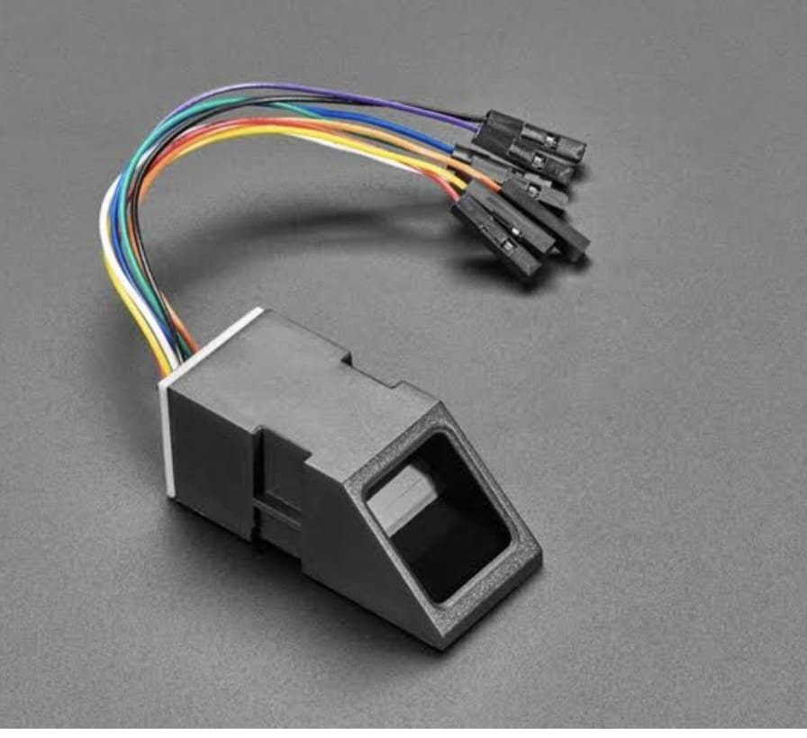
FINGERPRINT SENSOR
A fingerprint sensor is an electronic device used to capture a digital image of the fingerprint pattern.
The captured image is called a live scan. This live scan is digitally processed to create a biometric template which is stored and used for matching.

Slide 14
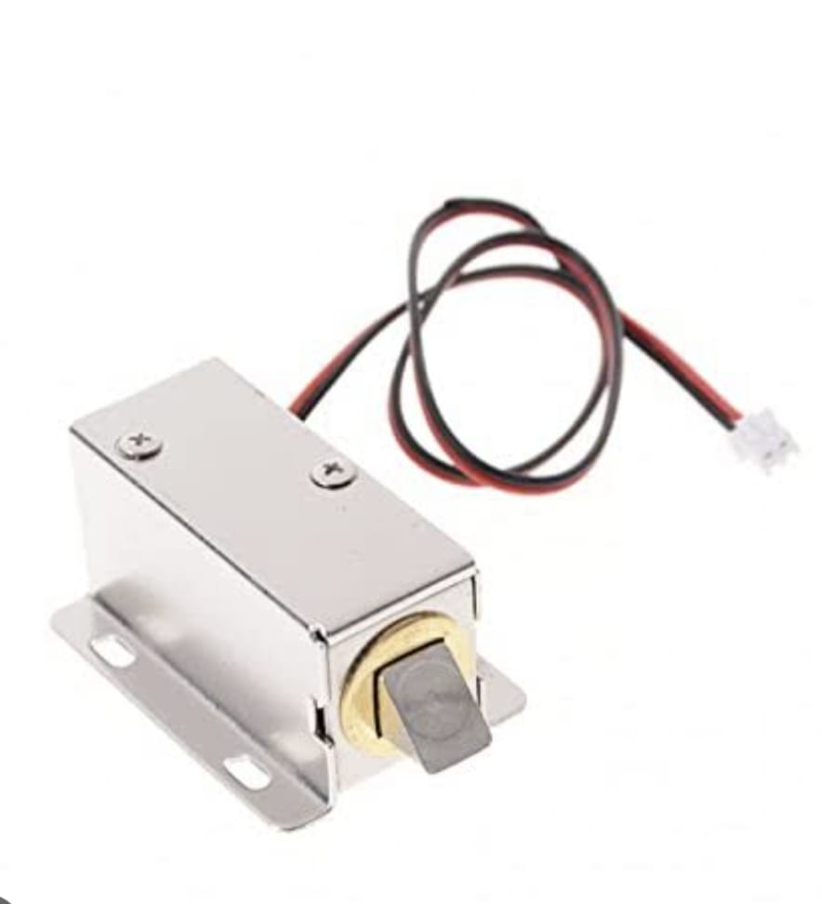
SOLENOID LOCK
12V Solenoid lock has a slug with a slanted cut and a good mounted bracket. Its basically an electronic lock designed for a basic cabinet.
It draws approx. 650mA of current when its activated,
Another advantage of this type of lock is, its programmable.

Slide 15
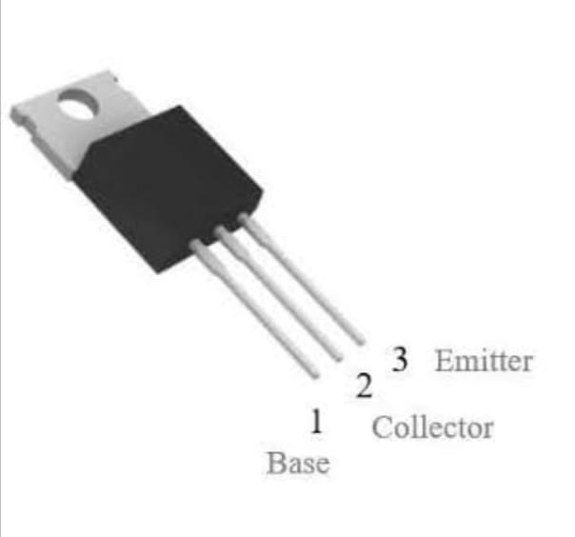
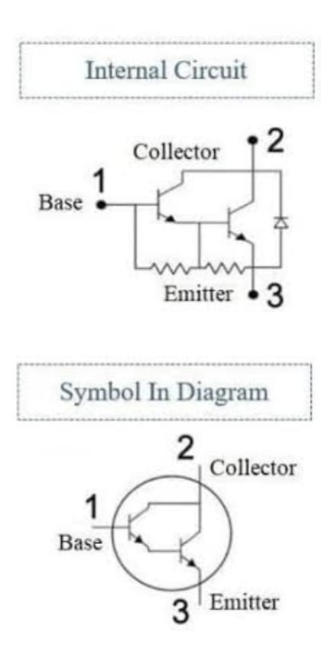
TIP122 TRANSISTOR
TIP122 transistor is a Darlington NPN transistor and it is very popular for its high current gain and high current . As the name suggests, the term Darlington means when the two transistors are available in a single pack for enhancing the gain at the output.
The manufacturing of this transistor can be done like a switch and amplifier purpose
In our application its acts as a switch.

Slide 16
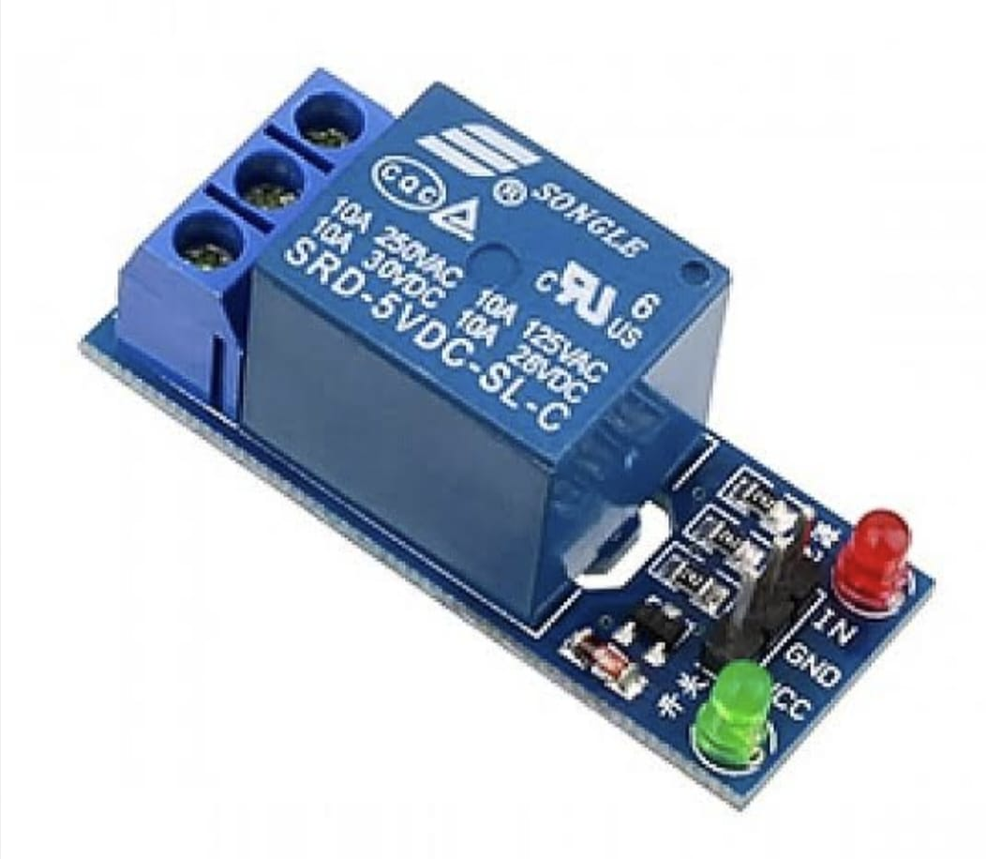
5 VOLTS RELAY
The 5V relay module requires a 5V signal delivered from a microcontroller or sensor to trigger the switch. Its working is also very simple. When the input pin is HIGH, the relay turns on, and when the input is LOW it turns off.
Here we use this device to get the required 5V at the solenoid output
Its an optional device to get the proper output we use this device here.

Slide 17
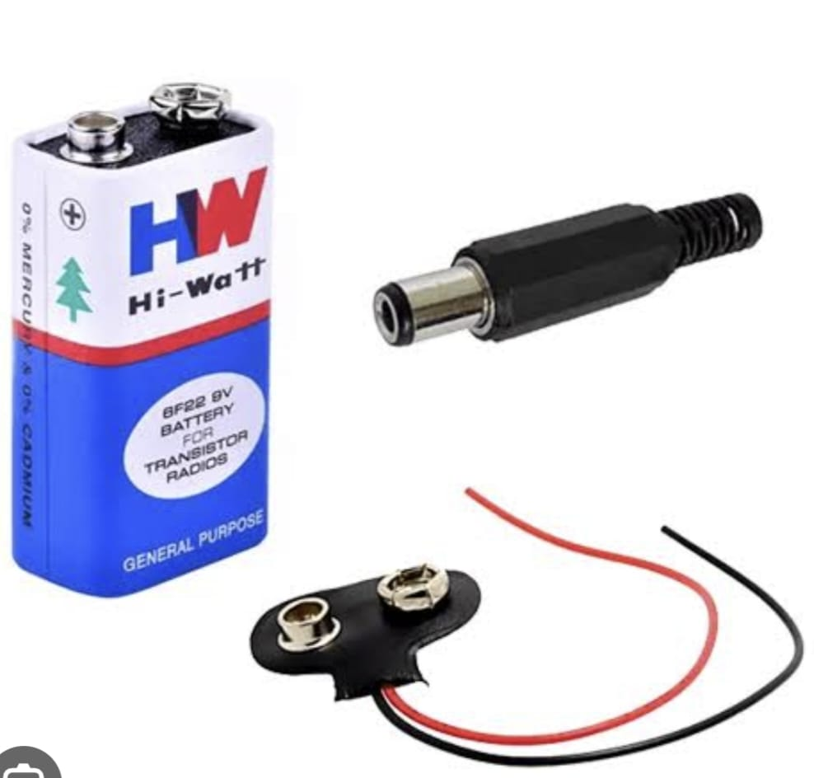
BATTERIES AND WIRES
The supplied input power is from these batteries, it stores the energy and it transfers the same,
The only advantage is that we can use these batteries to avoid power cut problems
WIRES these are the basic elements used for connecting the components physically.

Slide 18
OBJECTIVES
Unlike passwords and other options fingerprints is a easy to use and convenient in some emergency cases.
It has a recognition system which include a faster speed and time reduces.
To create an advance system that will allow the user to save and delete a fingerprint in the system.
For the physically handicapped persons involving blind, uniped, etc can use this technology in their environment and operated conveniently.

Slide 19
METHODOLOGY
Fingerprints can be converted into 2D digital messages and can be stored in the memory element by using associative memory applications.
On comparing the input fingerprint with the saved digital messages, the program is written such that to open the lock (if same)
By using Arduino uno as a processor, we interface the fingerprint sensors and add program to it by Arduino IDE software.
Before , we add the well known fingerprints to the memory element.

Slide 20
METHODOLOGY
The program is made such that it accepts the fingerprint from the person and opens the lock accordingly.
In this , we implement the lock on the vertices of the door, and the sensor made fitted outside the door.
The entire circuit is made immerged in the walls.
Here we use the DC batteries and it avoids the non working state in the power cut situations.

Slide 21
ADVANTAGES
Increased security
Convenience
Customisation
Easy to install
Reliable
Versatile

Slide 22
DISADVANTAGES
Expensive
Bulky
Replacement is difficult
Power drained off for small duration

Slide 23
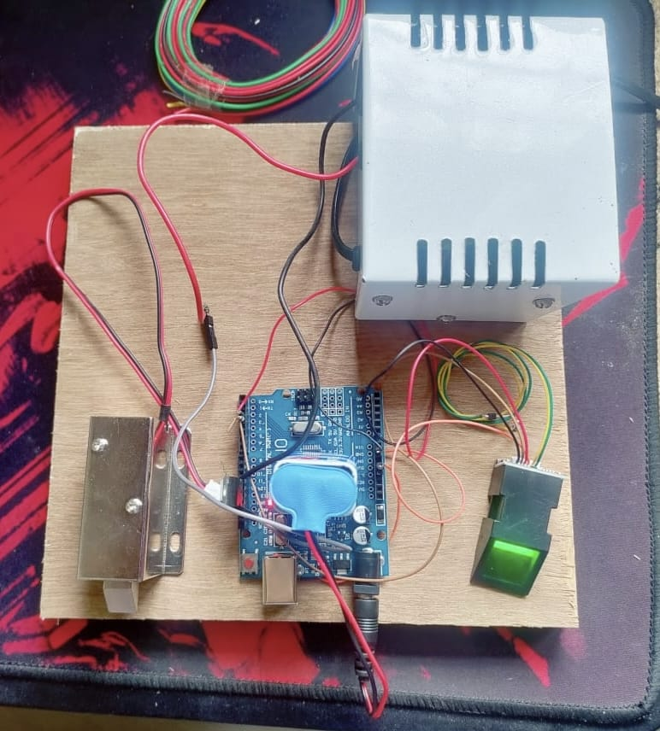
EXPECTED OUTCOME
On beginning with the lock present in the OFF state (closed)
It accepts the fingerprint from the person as input
by comparing the fingerprint with stored data
If anyone of the stored data is matched , the lock turns to ON state (open) else it remains in the OFF state (close).

Slide 24
REFERENCES
[1] “(PDF) Password Based Door Lock System Using Arduino,” Research Gate. https://www.researchgate.net/publication/330998913_Password_Based_Door_Lock_System_Using_Arduino (accessed Aug. 08, 2021).
[2] Meenakshi, N, M Monish, K J Dikshit, and S Bharath. “Arduino Based Smart Fingerprint Authentication System.” In 2019 1st International Conference on Innovations in Information and Communication Technology (ICIICT), 1–7. CHENNAI, India: IEEE, 2019.
[3] Areed, Marwa F. “A Keyless Entry System Based on Arduino Board with Wi-Fi Technology.” Measurement 139 (June 2019): 34–39. https://doi.org/10.1016/j.measurement.2019.02.028.
[4] “Arduino-primarily based clever Fingerprint Authentication device."- All over the world, homes

Slide 25
REFERENCES
[5] MD. Khayrul islam , Allimul Rajee “FINGERPRINT DOOR LOCK SYSTEM” Research Gate. 2023 (biometric technology)
[6] Md. AL Imran , Wahid Sabbir “PASSWORD BASED SMART DOOR LOCKING SYSTEM” Research Gate,2022, (password keypad)
[7] ALI Hussain , “AUTOMATIC DOOR LOCK SYSTEM” , Research Gate, 2022, (electromagnetic and sensor technology)
[8] Falohun A S , Oluwole Adegbola , Bukola O Makinde , Titipole Helen Akin Olayemi , “SMART DOOR LOCK WITH AN EMBEDDED SPY CAMERAS” published by ABAYOMI EBENEZER ADEYEGE ,2021 , (time of flight technology).
[9] Sandesh Parajuli , “RFID AND BLUETOOTH BASED SMART DOOR LOCKING SYSTEM” , 2021 , (NON- Contact and Bluetooth technology).

Slide 26
REFERENCES
[10] Afolabi A, Alice O. On Securing a door with finger print biometric technique. Transactions on Machine Learning and Artificial Intelligence.
[11] Website link : https://docs.arduino.cc/hardware/uno-rev3 , 2022
[12]Websitelink:https://www.explainthatstuff.com/fingerprintscanners.html 2022
[13] Website link : https://www.electronics.com.bd/12v-solenoid-lock, 2022
[14] Website link : https://www.elprocus.com/lcd-16x2-pin-configuration-and-its-working/, 2022

Slide 27
REFERENCES
[15] Website link : https://components101.com/transistors/tip122-pinout-equivalent-datasheet, 2022
[16] Website link : https://www.indiamart.com/proddetail/12v-1a-adaptor-12721243248.html, 2022
[17] Website link : https://components101.com/mosfets/irfz44n-datasheet-pinout-features, 2022
[18] Website link : https://www.amazon.com/Degraw-DIY-Speaker-KitAmplifier/dp/B07CRVRG83 , 2022
[19] Website link : https://www.ledgreenlightint.com/ , 2022

Slide 28
THANK YOU

